Slide 1
12. Searching and Sorting
Rutgers University
1.1–1.2
Notes:
(12.1) Searching
(12.1a) Given an array of values, write a linear(sequential) search method to locate a specified value in the array. If the value is not present in the array, indicate that.
(12.1b) Given an ordered array of values, write a non-recursive binary search method to locate a specified value in the array. If the value is not present in the array, indicate that.
(12.1c) Count the number of comparisons made when a given search algorithm is executed and the search key and the array of values are provided.
(12.1d) Identify all elements in a given array that are examined when a given search algorithm is executed and the search key and the array of values are provided.
(12.1e) Determine the best case, average case, and worst case Big-O analysis when a given search algorithm is executed and the search key and the array of values are provided.
(12.2) Sorting
(12.2a) Given an array of values, give a step-by-step illustration of executing the selection sorton the array. State the array contents after each pass of the sort. Have to provide info on this…not in text.
(12.2b) Given an array of values, give a step-by-step illustration of executing the insertion sorton the array. State the array contents after each pass of the sort.
(12.2c) Determine the best case, average case, and worst case Big-O analysis of the selection search.
(12.2d) Determine the best case, average case, and worst case Big-O analysis of the insertion search.
(12.2e) Write a program that sorts an array of numerical using the selection/insertion sort
(12.2f) Write a program that sorts an array of objects using the selection/insertion sort.

Slide 2
12. Searching and Sorting
A typical client
Linear/sequential search
Binary search
Selection sort
Insertion sort
Adopted and modified from Slides by Sedgewick and Wayne

Slide 3

A typical client: acceptList filter
A rejectList is a list of entities to be rejected for service.
Examples: Overdrawn account Spammers
An acceptList is a list of entities to be accepted for service.
Examples: Account in good standing Friends and relatives
acceptList filter
Read a list of strings from an acceptList file.
Read strings from StdIn and write to StdOut only those in the acceptList.
Example. Email spam filter
(message contents omitted)
bob@office
carl@beach
marvin@spam
bob@office
bob@office
mallory@spam
dave@boat
eve@airport
alice@home
...
✓
✓
bob@office
carl@beach
bob@office
bob@office
dave@boat
alice@home
...
alice@home
bob@office
carl@beach
dave@boat
✓
acceptList
StdIn
✓
StdOut
✓
✓

Slide 4
Search client: acceptList filter
public class AcceptFilter
{
public static int search(String key, String[] a)
// Search method (stay tuned).
public static void main(String[] args)
{
String[] words = StdIn.readAllStrings();
while (!StdIn.isEmpty())
{
String key = StdIn.readString();
if (search(key, words) != -1)
StdOut.println(key);
}
}
}
words
alice@home
bob@office
carl@beach
dave@boat
% more test.txt
bob@office
carl@beach
marvin@spam
bob@office
bob@office
mallory@spam
dave@boat
eve@airport
alice@home
% java AcceptFilter < test.txt
bob@office
carl@beach
bob@office
bob@office
dave@boat
alice@home

Slide 5
12. Searching and Sorting
A typical client
Linear/Sequential search
Binary search
Selection sort
Insertion sort

Slide 6

Strawman implementation: Linear search
Given an array of values, write a linear (sequential) search method to locate a specified value in the array. If the value is not present in the array, indicate that.
LO 12.1a
Sequential search
Check each array entry 0, 1, 2, 3, ... for match with search string.
If match found, return index of matching string.
If not, return −1.
i | a[i]
0 | alice
1 | bob
2 | carlos
3 | carol
4 | craig
5 | dave
6 | erin
7 | eve
8 | frank
9 | mallory
10 | oscar
11 | peggy
12 | trent
13 | walter
14 | wendy
oscar?
public static int search(String key, String[] a)
{
for (int i = 0; i < a.length; i++)
if (a[i].compareTo(key) == 0) return i;
return -1;
}
Match found.
Return 10
Still, this was even easier than I thought!

Slide 7
Best, worst and average case of linear search
Determine the best case, average case, and worst case Big-O analysis when a given search algorithm is executed and the search key and the array of values are provided.
LO 12.1c
Best case. Oscar is the first record (1 comparison)
Worst case. Oscar is the last record (n comparisons)
Average case. Oscar is the middle record (n/2 comparisons)
i | a[i]
0 | alice
1 | bob
2 | carlos
3 | carol
4 | craig
5 | dave
6 | erin
7 | eve
8 | frank
9 | mallory
10 | oscar
11 | peggy
12 | trent
13 | walter
14 | wendy
oscar?
public static int search(String key, String[] a)
{
for (int i = 0; i < a.length; i++)
if (a[i].compareTo(key) == 0) return i;
return -1;
}

Slide 8
Understanding linear search
Identify all elements in a given array that are examined when a given search algorithm is executed and the search key and the array of values are provided.
LO 12.1d
Identify. All elements that are inspected during linear search
i | a[i]
0 | alice
1 | bob
2 | carlos
3 | carol
4 | craig
5 | dave
6 | erin
7 | eve
8 | frank
9 | mallory
10 | oscar
11 | peggy
12 | trent
13 | walter
14 | wendy
comparisons. 11 names inspected
oscar?
Match found.
Return 10

Slide 9
Mathematical analysis of acceptList filter using sequential search
xwnzb
lnuqv
lnuqv
czpwx
czpwx
dqwak
idhld
dobqi
dobqi
tsirv
dqwak
dobqi
idhld
dqwak
dobqi
lnuqv
xwnzb
idhld
bshla
xwnzb
Model
N strings on the acceptList.
cN transactions for constant c.
String length not long.
transactions
acceptList
dobqi
xwnzb
dqwak
lnuqv
czpwx
bshla
idhld
utfyw
hafah
tsirv
Analysis
A random search hit checks about half of the N strings on the acceptList, on average.
A random search miss checks all of the N strings on the acceptList, on average.
Expected order of growth of running time: N².

Slide 10
Random representative inputs for searching and sorting
Generate N random strings of length L from a given alphabet
public class Generator
{
public static String randomString(int L, String alpha)
{
char[] a = new char[L];
for (int i = 0; i < L; i++) { int t = StdRandom.uniform(alpha.length());
a[i] = alpha.charAt(t);
}
return new String(a);
}
public static void main(String[] args)
{
int N = Integer.parseInt(args[0]);
int L = Integer.parseInt(args[1]);
String alpha = args[2];
for (int i = 0; i < N; i++)
StdOut.println(randomString(L, alpha));
}
}
% java Generator 10 3 abc
bab
bab
bbb
cac
aba
abb
bab
ccb
cbc
bab
% java Generator 15 8 0123456789
62855405
83179069
79061047
27258805
54441080
76592141
95956542
19442316
75032539
10528640
42496398
34226197
10320073
80072566
87979201
good chance of duplicates
not much chance
of duplicates
% java Generator 1 60 actg
tctatagggtcgtttgcgaagcctacacaaaagtagttgttggacaacgattgacaaaca

Slide 11
Test client for linear search
Print time required for 10N searches in a whitelist of length N
public class TestSS
{
public static int search(String key, String[] a)
{
for (int i = 0; i < a.length; i++)
if ( a[i].compareTo(key) == 0 ) return i;
return -1;
}
public static void main(String[] args)
{
String[] words = StdIn.readAllStrings();
int N = words.length;
double start = System.currentTimeMillis()/1000.0;
for (int i = 0; i < 10*N; i++)
{
String key = words[StdRandom.uniform(N)];
if (search(key, words) == -1)
StdOut.println(key);
}
double now = System.currentTimeMillis()/1000.0;
StdOut.println(Math.round(now-start) + " seconds");
}
}
a-z = abcdefghijklmnopqrstuvwxyz
% java Generator 10000 10 a-z | java TestSS
3 seconds
generate 10,000
ten-letter words
(lowercase)
print time for
100,000 searches
random successful search
(no output)

Slide 12
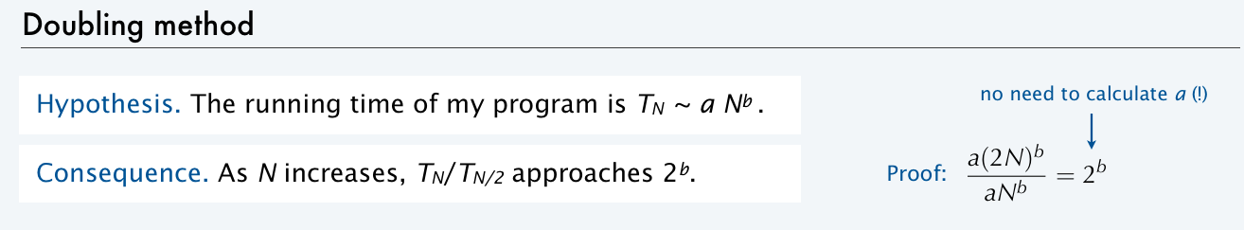
Empirical tests of sequential search
N | TN (seconds) | TN/TN/2 | transactions per second
10,000 | 3 |  | 3,333
20,000 | 9 |  | 2,222
40,000 | 35 | 3.9 | 1,143
80,000 | 149 | 4.3 | 536
...
1.28 million | 38,500 | 4 | 34
% java Generator 10000 ...
3 seconds
% java Generator 20000 ...
9 seconds
% java Generator 40000 ...
35 seconds
% java Generator 80000 ...
149 seconds
acceptList filter scenario
acceptList of size N.
10N transactions.
... = 10 a-z | java TestSS
more than
10.5 hours
1.28 million transactions
at a rate of 34 per second
and dropping
Hmmm. That doesn't seem too good.
Validates hypothesis that order of growth is N² .
Does NOT scale.
Notes:
So now we can use this test client to go ahead and do doubling tests
So again, acceptList of size n and 10n transactions
So we get 3 seconds for 10000. If we run it for 20000, it takes 9 seconds and also keeping track of the transactions per second, just as a measure of how well we're doing running it for 40000. It takes 35 seconds. Now we start to compute the ratio of the time for n over the time for n over 2,
80 thousand, 149 seconds. So bob wants to have is million customers. Well, it's going to take 38000 seconds. That's 10 hours just to do the this acceptList thing. And what's worse is it's down to 34 transactions per second and dropping. So bob can see that's maybe not too good. And if we go and just look a little more carefully what the doubling test means, remember that this ratio tells us the exponent in the in the growth. If the running time is proportional to a constant times n to the be with this doubling test. If you take log to the base 2 of this ratio, that's going to give the exponent. So this says that the order grossed is n squared. 16:28 Log base 2 of 4 is 2. So that validates the mathematical model. And we have a lot of confidence that the running time of this thing is going to be proportional to the square of the size of the acceptList. And that doesn't scale. 16:42 And that's not going to work too well for bob's business. So we're going to have to look at better methods than sequential search.

Slide 13
Sequential Search: Efficiency Analysis
Check each element in sequence to find the target
3 | 5 | 12 | 2 | 56 | 32 | 8 | 14
0 | 1 | 2 | 3 | 4 | 5 | 6 | 7 | 8 | 9
Array index
Scenarios
Best case
which number is fastest to find (requires the least number of comparisons)?
Worst case
which number is the longest to find (requires the largest number of comparisons)?
Average case
average all possibilities (takes into account the probability of a possibility)

Slide 14
Efficiency of a Sequential Search
Best case O(1)
Locate desired item first
Worst case O(n)
Must look at all the items
Average case O(n)
Must look at half the items
O(n/2) is still O(n)
BUT>>>>Doing this search 10N times is REALLY NOT a good choice.

Slide 15
Recursive Sequential Search-What does it look like?
public static int linearSearch(int[] a, int pos, int target)
{
if(pos >= a.length){
return -1;
}else if(a[pos]==target){
return pos;
}else{
return linearSearch(a, pos + 1, target);
}
}
Make 1 comparison (basic operation)
T(0) = 1: searching empty array is constant.
T(n) = T(n – 1) + 1 : searching an array of n elements = time to search array with n-1 elements + cost of comparing first element.

Slide 16
Recursive Sequential Search
public static int linearSearch(int[] a, int pos, int target)
{
if(pos >= a.length){
return -1;
}else if(a[pos]==target){
return pos;
}else{
return linearSearch(a, pos + 1, target);
}
}
T(n-1) = T(n-2) + 1
T(n) = T(n-1) + 1 = T(n-2) + 2 = T(n – 3) + 3…T(n – i) + i. (i increases to n)
T(n) = T(0) + n = 1 + n = n: O(n)

Slide 17
12. Searching and Sorting
A typical client
Linear/Sequential search
Binary search
Selection sort
Insertion sort

Slide 18
Non-Recursive Binary Search

Slide 19
Binary Search
Searching an ordered array
How to find a target value?
one test can rule out a whole region of the array
How to find the middle point of the array?
middle = (left + right) / 2 (integer division)
3 | 5 | 12 | 22 | 56 | 62 | 85 | 94 | 95 | 99
0 | 1 | 2 | 3 | 4 | 5 | 6 | 7 | 8 | 9
Array index
Left
Middle
Right

Slide 20
Binary Search
Searching an ordered array
How to find 12?
3 | 5 | 12 | 22 | 56 | 62 | 85 | 94 | 95 | 99
0 | 1 | 2 | 3 | 4 | 5 | 6 | 7 | 8 | 9
Array index
12 == 56? no | 12 < 56? yes
12 == 5? no | 12 < 5? no
12 == 12? yes | Found it!
Left
Middle
Right
Left | Right | Middle
0 | 9 | 4
0 | 3 | 1
2 | 3 | 2

Slide 21
Binary Search (non-recursive): Efficiency Analysis
public static int binarySearch (int[] array, int n, int target) {
int left = 0, right = n - 1;
while (left <= right) {
int mid = (left + right) / 2;
if (target == array[mid]) {
return mid; //position
}
if (target < array[mid]) {
right = mid - 1;
} else {
left = mid + 1;
}
}
return -1; //not found
}
Notes:
Express the running time as a function of the input size
Simplify by keeping only the fastest growing term
Drop constants
Drop insignificant terms

Slide 22
Binary Search(non-recursive): Efficiency Analysis
public static int binarySearch (int[] array, int n, int target) {
int left = 0, right = n - 1;
while (left <= right) {
int mid = (left + right) / 2;
if (target == array[mid]) {
return mid; //position
}
if (target < array[mid]) {
right = mid - 1;
} else {
left = mid + 1;
}
}
return -1; //not found
}
The loop is executed y times, that is how many times we can divide the array in half. Look at n = 2^{y}
Recall the log function:
b = a^{c} is equivalent to log_{a}b = c
n = 2^{y} is equivalent to log₂n = y
which means that the loop is executed at most log n times
Notes:
Express the running time as a function of the input size
Simplify by keeping only the fastest growing term
Drop constants
Drop insignificant terms

Slide 23
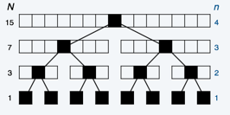
Binary Search(non-recursive): Efficiency Analysis
public static int binarySearch (int[] array, int n, int target) {
int left = 0, right = n - 1
while (left <= right) {
int mid = (left + right) / 2;
if (target == array[mid]) {
return mid; //position
}
if (target < array[mid]) {
right = mid - 1;
} else {
left = mid + 1;
}
}
return -1; //not found
}
f(n) =1 + f(n/2)
…= f(n/4) + 2
…= f(n/8) + 3
Look at n = 2^{y}
…= f(2^{y}/2^{k}) + k
Look at y = k
…= f(1) + y
O(y)
But y = log₂n
O(log n)
Notes:
Express the running time as a function of the input size
Simplify by keeping only the fastest growing term
Drop constants
Drop insignificant terms

Slide 24
Binary Search(non-recursive): Efficiency Analysis
public static int binarySearch (int[] array, int n, int target) {
int left = 0, right = n - 1
while (left <= right) {
int mid = (left + right) / 2;
if (target == array[mid]) {
return mid; //position
}
if (target < array[mid]) {
right = mid - 1;
} else {
left = mid + 1;
}
}
return -1; //not found
}
f(n) =1 + f(n/2)
…= f(n/4) + 2
…= f(n/8) + 3
Look at n = 2^{y}
…= f(2^{y}/2^{k}) + k
Look at y = k
…= f(1) + y
O(y)
But y = log₂n
O(log n)
O(1) to do a comparison
comparison
Repeat with half the search range.
Notes:
Express the running time as a function of the input size
Simplify by keeping only the fastest growing term
Drop constants
Drop insignificant terms

Slide 25
Binary Search(non-recursive): Efficiency Analysis –looking for 17
Iteration | Left | Right | Middle | array elt comparisons
1
2
3
4-
2 | 5 | 17 | 23 | 34 | 67 | 78 | 89 | 91
0 | 1 | 2 | 3 | 4 | 5 | 6 | 7 | 8
public static int binarySearch (int[] array, int n, int target) {
int left = 0, right = n - 1
while (left <= right) {
int mid = (left + right) / 2;
if (target == array[mid]) {
return mid; //position
}
if (target < array[mid]) {
right = mid - 1;
} else {
left = mid + 1;
}
}
return -1; //not found
}
Notes:
Express the running time as a function of the input size
Simplify by keeping only the fastest growing term
Drop constants
Drop insignificant terms

Slide 26
Binary Search(non-recursive): Efficiency Analysis –looking for 17
Iteration | Left | Right | Middle | array elt comparisons
1 | 0 | 8 | 4 | 1+1
2 | 0 | 3 | 1 | 1+ 1
3 | 2 | 3 | 2 | 1
4-
2 | 5 | 17 | 23 | 34 | 67 | 78 | 89 | 91
0 | 1 | 2 | 3 | 4 | 5 | 6 | 7 | 8
public static int binarySearch (int[] array, int n, int target) {
int left = 0, right = n - 1
while (left <= right) {
int mid = (left + right) / 2;
if (target == array[mid]) {
return mid; //position
}
if (target < array[mid]) {
right = mid - 1;
} else {
left = mid + 1;
}
}
return -1; //not found
}
Notes:
Express the running time as a function of the input size
Simplify by keeping only the fastest growing term
Drop constants
Drop insignificant terms

Slide 27
Recursive Binary Search

Slide 28
Binary Search Recursive
public static int binSearch (int[] arr, int from, int to, int target) {
if (from > to) {
return -1; //val not found
}
int mid = (from + to)/2;
if (arr[mid] == target){
return mid;
}
else if (target > arr[mid]){
return binSearch(arr,mid+1,to,target);
}
else{
return binSearch(arr,from,mid-1,target);
}
}

Slide 29
Summary of analyzing runtime:
It takes O(1) time to do the comparison, then it cuts the search range in half.
T(N) = T(N/2) + 1
Repeat the recurrence...
T(N) = T(N/4) + 2
= T(N/8) + 3 ...
= T(N/2^{k}) + k
Round up N to nearest power of 2:
N ≤ 2^{m}
T(N) ≤ T(2^{m}/2^{k}) + k
Let k = m.
T(N) ≤ T(2^{m}/2^{m}) + m = T(1)+m = 1+m = O(m)
If N=2^{m}, then m=log₂N.
So T(N) = O(log N)

Slide 30
Binary search
Binary search
Keep the array in sorted order (stay tuned).
Examine the middle key.
If it matches, return its index.
If it is larger, search the half with lower indices.
If it is smaller, search the half with upper indices.
i | a[i]
0 | alice
1 | bob
2 | carlos
3 | carol
4 | craig
5 | dave
6 | erin
7 | eve
8 | frank
9 | mallory
10 | oscar
11 | peggy
12 | trent
13 | walter
14 | wendy
oscar?
Match found.
Return 10

Slide 31
Best, worst and average case of binary search
LO 12.1e
Best case. Oscar is the first record (log N comparison)
Worst case. Oscar is the last record (log N comparisons)
Average case. Oscar is the “middle” record (log N comparisons)
Notes:
(12.1e) Determine the best case, average case, and worst case Big-O analysis when a given search algorithm is executed and the search key and the array of values are provided.

Slide 32

Empirical tests of binary search
N | TN (seconds) | TN/TN/2 | transactions per second
100,000 | 1
200,000 | 3
400,000 | 6 | 2 | 67,000
800,000 | 14 | 2.35 | 57,000
1,600,000 | 33 | 2.33 | 48,000
10.28 million | 264 | 2 | 48,000
acceptList filter scenario
acceptList of size N.
10N transactions.
% java Generator 100000 ...
1 seconds
% java Generator 200000 ...
3 seconds
% java Generator 400000 ...
6 seconds
% java Generator 800000 ...
14 seconds
% java Generator 1600000 ...
33 seconds
... = 10 a-z | java TestBS
a-z = abcdefghijklmnopqrstuvwxyz
nearly 50,000 transactions
per second, and holding
Validates hypothesis that order of growth is NlogN.
Great! But how do I get the list into sorted order at the beginning?
Will scale.

Slide 33
Recursive Searches
Recursion eats up memory because it has to create local copies of all the parameters.
We have to pass parameters because they change at the recursive step.
Same algorithm as non-recursive (same big picture)

Slide 34
Efficiency Analysis
Linear Search: O(n) linear growth
Binary Search: O(log n) logarithmic growth
O(log n) grows slower than O(n) therefore Binary Search is faster than Linear Search
Input size (n)

Slide 35
12. Searching and Sorting
A typical client
Linear/Sequential search
Binary search
Selection sort
Insertion sort

Slide 36
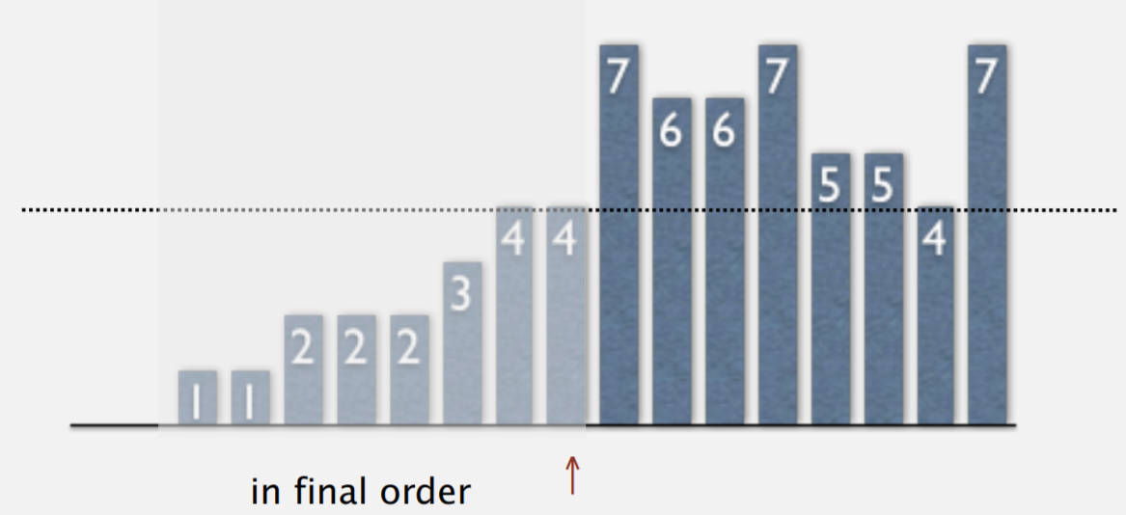
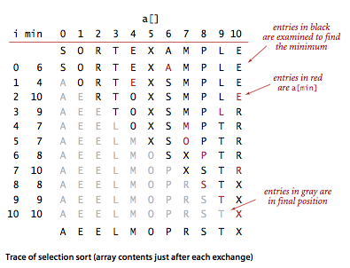
Selection sort
Given an array of values, give a step-by-step illustration of executing the selection sort on the array. State the array contents after each pass of the sort.
LO 12.2a
Main idea
In iteration i, find the index min of the smallest remaining entry.
Swap a[i] and a[min]

Slide 37
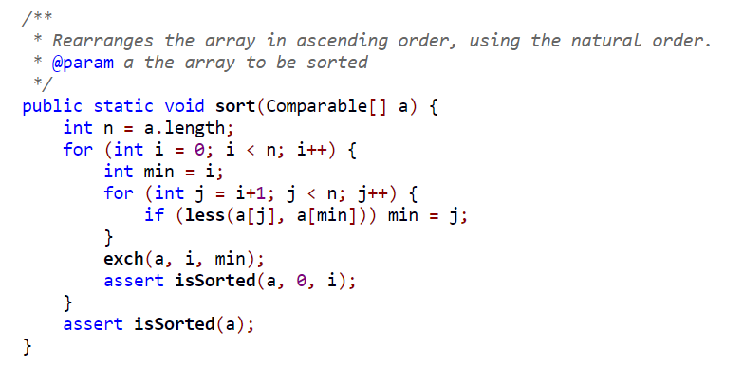
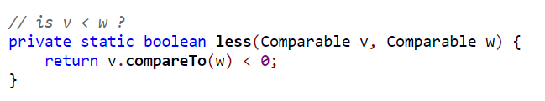
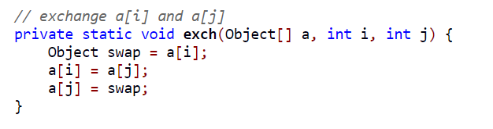
Selection sort implementation (comparable objects)
Write a program that sorts an array of objects using the selection/insertion sort.
LO 12.2a
Sorting an array of comparable using selection sort
Class of object has implemented a compare to method
https://algs4.cs.princeton.edu/21elementary/Selection.java.html

Slide 38
Consider the following array:
11 | 7 | 12 | 14 | 19 | 1 | 6 | 18 | 8 | 20
public static void selection(int[] a){
int n = a.length;
for (int i= 0; i < n; i++){
int minPos = i;
for (int j = i+1; j < n; j++){
if (a[j] < a[minPos]){
minPos = j;
}
}
int temp = a[i];
a[i] = a[minPos];
a[minPos] = temp;
}
}
What list results after three passes of
the selection sort?
0 | 11 | 7 | 12 | 14 | 19 | 1 | 6 | 18 | 8 | 20
1
2
3 |  |  | 7 | 14 | 19 | 11 | 12 | 18 | 8 | 20
4 |  |  | 7 | 8 | 19 | 11 | 12 | 18 | 14 | 20
5 |  |  | 7 | 8 | 11 | 19 | 12 | 18 | 14 | 20
6 |  |  | 7 | 8 | 11 | 12 | 19 | 18 | 14 | 20
7 |  |  | 7 | 8 | 11 | 12 | 14 | 18 | 19 | 20
8 |  | 6 | 7 | 8 | 11 | 12 | 14 | 18 | 19 | 20
Note that there will be n iterations for n numbers…so more rows here.
Notes:
1 7 12 14 19 11 6 18 8 20
1 6 12 14 19 11 7 18 8 20
1 6 7 14 19 11 12 18 8 20
1 6 7 8 19 11 12 18 14 20
1 6 7 8 11 19 12 18 14 20
1 6 7 8 11 12 19 18 14 20
1 6 7 8 11 12 14 18 19 20
1 6 7 8 11 12 14 18 19 20
1 6 7 8 11 12 14 18 19 20
1 6 7 8 11 12 14 18 19 20

Slide 39
Selection sort trace
LO 12.2a
Note the number of iterations is n→last iteration is sorted array.
public static void selection(int[] a){
int n = a.length;
for (int i= 0; i < n; i++){
int minPos = i;
for (int j = i+1; j < n; j++){
if (a[j] < a[minPos]){
minPos = j;
}
}
int temp = a[i];
a[i] = a[minPos];
a[minPos] = temp;
printArray(a);
}
}

Slide 40
Selection sort trace
LO 12.2a
0 | 14 | 34 | 16 | 13 | 56 | 81 | 22 | 18
1 | 13 | 34 | 16 | 14 | 56 | 81 | 22 | 18
2 | 13 | 14 | 16 | 34 | 56 | 81 | 22 | 18
3 | 13 | 14 | 16 | 34 | 56 | 81 | 22 | 18
4 | 13 | 14 | 16 | 18 | 56 | 81 | 22 | 34
5 | 13 | 14 | 16 | 18 | 22 | 81 | 56 | 34
6 | 13 | 14 | 16 | 18 | 22 | 34 | 56 | 81
7 | 13 | 14 | 16 | 18 | 22 | 34 | 56 | 81
8 | 13 | 14 | 16 | 18 | 22 | 34 | 56 | 81
public static void selection(int[] a){
int n = a.length;
for (int i= 0; i < n; i++){
int minPos = i;
for (int j = i+1; j < n; j++){
if (a[j] < a[minPos]){
minPos = j;
}
}
int temp = a[i];
a[i] = a[minPos];
a[minPos] = temp;
printArray(a);
}
}

Slide 41
Selection sort trace—already ordered.
LO 12.2a
0 | 1 | 3 | 6 | 13 | 56 | 81 | 82 | 98
1 | 1 | 3 | 6 | 13 | 56 | 81 | 82 | 98
2 | 1 | 3 | 6 | 13 | 56 | 81 | 82 | 98
3 | 1 | 3 | 6 | 13 | 56 | 81 | 82 | 98
4 | 1 | 3 | 6 | 13 | 56 | 81 | 82 | 98
5 | 1 | 3 | 6 | 13 | 56 | 81 | 82 | 98
6 | 1 | 3 | 6 | 13 | 56 | 81 | 82 | 98
7 | 1 | 3 | 6 | 13 | 56 | 81 | 82 | 98
8 | 1 | 3 | 6 | 13 | 56 | 81 | 82 | 98
public static void selection(int[] a){
int n = a.length;
for (int i= 0; i < n; i++){
int minPos = i;
for (int j = i+1; j < n; j++){
if (a[j] < a[minPos]){
minPos = j;
}
}
int temp = a[i];
a[i] = a[minPos];
a[minPos] = temp;
printArray(a);
}
}

Slide 42
Selection Sort
The idea is to repeatedly find the biggest (or smallest) item in the array and move it to the end
to keep the array sorted in increasing (or decreasing) order
What can you say about the efficiency of the Selection Sort?
Best Case?
Worst Case?
Animation: https://visualgo.net/bn/sorting
http://cse.iitkgp.ac.in/pds/notes/swf/selection.html (FIREFOX)
Notes:
N^2 always

Slide 43
Best, average and worst case of selection sort
Analysis
Selection sort selects the minimum element of the array segment a[i+1…a.length-1] and swaps with element in the i^{th} location
The array a[0..i] remains sorted at the i^{th} iteration
The amount of work that needs to be done remains the same regardless of the values in the array ~ O(n²)
Hence best, average and worst cases are all O(n²) for selection sort

Slide 44
12. Searching and Sorting
A typical client
Linear/Sequential search
Binary search
Selection sort
Insertion sort

Slide 45
Insertion Sort – my favorite n² sort
One way of thinking of inserting sort:
Imagine you are playing a card game.
The cards you are holding on your hand are sorted.
The dealer hands you one card.
You have to put it into the correct place so that the cards you’re holding are sorted.
Animation: https://www.ee.ryerson.ca/~courses/coe428/sorting/insertionsort.html
(Safari/Firefox)

Slide 46
Consider the following array:
Sort in ascending order using insertion sort!
14 | 13 | 12 | 18 | 11 | 19 | 15 | 17
public static void insertionSort(int[] A){
int itemsSorted;
for (itemsSorted = 1; itemsSorted < A.length; itemsSorted++){
int temp = A[itemsSorted];
int loc = itemsSorted - 1;
while (loc >= 0 && A[loc] > temp){
A[loc + 1] = A[loc];
loc = loc - 1;
}
A[loc + 1] = temp;
printArray(A);
}
}
 |  | 0 | 1 | 2 | 3 | 4 | 5 | 6 | 7
is | temp | 14 | 13 | 12 | 18 | 11 | 19 | 15 | 17
1 | 13 | 13 | 14 | 12 | 18 | 11 | 19 | 15 | 17
2 | 12 | 12 | 13 | 14 | 18 | 11 | 19 | 15 | 17
3 | 18 | 12 | 13 | 14 | 18 | 11 | 19 | 15 | 17
4 | 11 | 11 | 12 | 13 | 14 | 18 | 19 | 15 | 17
5 | 19 | 11 | 12 | 13 | 14 | 18 | 19 | 15 | 17
6 | 15 | 11 | 12 | 13 | 14 | 15 | 18 | 19 | 17
7 | 17 | 11 | 12 | 13 | 14 | 15 | 17 | 18 | 19

Slide 47
Consider the following array:
14 | 4 | 3 | 17 | 11 | 18 | 13 | 9 | 7 | 19
Which of the following lists represents the partially sorted list after
three passes of the insertion sort?
a. 3, 4, 11, 14, 13, 9, 7, 17, 18, 19
14, 4, 3, 9, 11, 7, 13, 17, 18, 19
c. 3, 4, 14, 17, 11, 18, 13, 9, 7, 19
d. 14, 4, 3, 17, 11, 18, 13, 7, 9, 19
0 | 1 | 2 | 3 | 4 | 5 | 6 | 7 | 8 | 9
Notes:
c

Slide 48
Consider the following array:
14 | 4 | 3 | 17 | 11 | 18 | 13 | 9 | 7 | 19
Which of the following lists represents the partially sorted list after
three passes of the insertion sort?
a. 3, 4, 11, 14, 13, 9, 7, 17, 18, 19
14, 4, 3, 9, 11, 7, 13, 17, 18, 19
c. 3, 4, 14, 17, 11, 18, 13, 9, 7, 19
d. 14, 4, 3, 17, 11, 18, 13, 7, 9, 19
0 | 1 | 2 | 3 | 4 | 5 | 6 | 7 | 8 | 9
4 | 14 | 3 | 17 | 11 | 18 | 13 | 9 | 7 | 19
3 | 4 | 14 | 17 | 11 | 18 | 13 | 9 | 7 | 19
Notes:
c

Slide 49
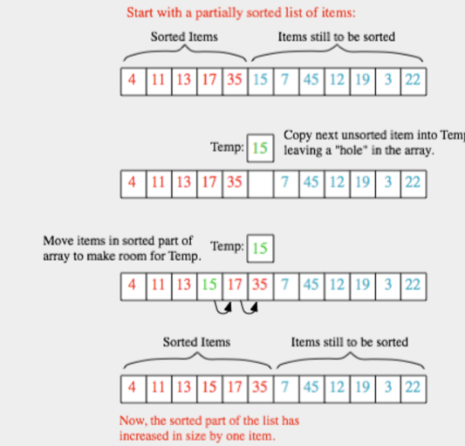
Insertion Sort

Slide 50
Insertion Sort: Efficiency Analysis
Best case: array is sorted in increasing order
count the number of comparisons
f(n) = 0+1+1+...+1
f(n) = n-1 O(n)
0 | 1 | 2 | 3 | 4 | 5
5 | 6 | 7 | 8 | 10 | 11
1st insertion | 0 compares
2nd insertion | 1 compares
3rd insertion | 1 compares
n^{th} insertion | 1 compares

Slide 51
Insertion Sort: Efficiency Analysis
Worst case: array is sorted in decreasing order
count the number of comparisons
0 | 1 | 2 | 3 | 4 | 5
11 | 10 | 8 | 7 | 6 | 5
1st insertion | 0 compares
2nd insertion | 1 compares
3rd insertion | 2 compares
n^{th} insertion | n-1 compares
1 + 2 + 3 + … + n-1 = 1 + 2 + ..+ (n – 1) = (1 + (n-1) )* (n-1)/2 = O(n²)
Arithmetic Series
Notes:
Arithmetic series
From i=0 to i=n SUM(x) = 1+2+3+4 = 10
(n(n+1))/2 = (4(4+1))/2 => The sum is n times the average of the first and last terms

Slide 52
Insertion Sort
Suppose you have the following array:
After four passes using the insertion sort, what is the resulting array?
25 | 4 | 16 | 32 | 76 | 9 | 12 | 15 | 25 | 89
public static void insertion2(int[] a){
int n = a.length;
for (int i = 1; i < n; i++){
for ( int j = i; j > 0; j--){
if(a[j-1] > a[j]){
int temp = a[j-1];
a[j-1] = a[j];
a[j] = temp;
}
else{
break;
}
}
printArray(a);
}
}
Notes:
4 25 16 32 76 9 12 15 25 89
4 16 25 32 76 9 12 15 25 89
4 16 25 32 76 9 12 15 25 89
4 16 25 32 76 9 12 15 25 89
4 9 16 25 32 76 12 15 25 89
4 9 12 16 25 32 76 15 25 89
4 9 12 15 16 25 32 76 25 89
4 9 12 15 16 25 25 32 76 89
4 9 12 15 16 25 25 32 76 89

Slide 53
Insertions Sort
public static void insertionSort(int[] A){
int itemsSorted;
for (itemsSorted = 1; itemsSorted < A.length; itemsSorted++) {
int temp = A[itemsSorted];
int loc = itemsSorted - 1;
while (loc >= 0 && A[loc] > temp) {
A[loc + 1] = A[loc];
loc = loc - 1;
}
A[loc + 1] = temp;
}
}

Slide 54
Insertion Sort
Suppose you have the following array:
After four passes using the insertion sort, what is the resulting array?
25 | 4 | 16 | 32 | 76 | 9 | 12 | 15 | 25 | 89
 | 0 | 1 | 2 | 3 | 4 | 5 | 6 | 7 | 8 | 9
1 | 4 | 25
2 | 4 | 16 | 25
3 | 4 | 16 | 25 | 32
4 | 4 | 16 | 25 | 32 | 76 | 9 | 12 | 15 | 25 | 89
5
6
7
8
9
public static void insertion2(int[] a){
int n = a.length;
for (int i = 1; i < n; i++){
for ( int j = i; j > 0; j--){
if(a[j-1] > a[j]){
int temp = a[j-1];
a[j-1] = a[j];
a[j] = temp;
}
else{
break;
}
}
printArray(a);
}
}
Notes:
4 25 16 32 76 9 12 15 25 89
4 16 25 32 76 9 12 15 25 89
4 16 25 32 76 9 12 15 25 89
4 16 25 32 76 9 12 15 25 89
4 9 16 25 32 76 12 15 25 89
4 9 12 16 25 32 76 15 25 89
4 9 12 15 16 25 32 76 25 89
4 9 12 15 16 25 25 32 76 89
4 9 12 15 16 25 25 32 76 89

Slide 55
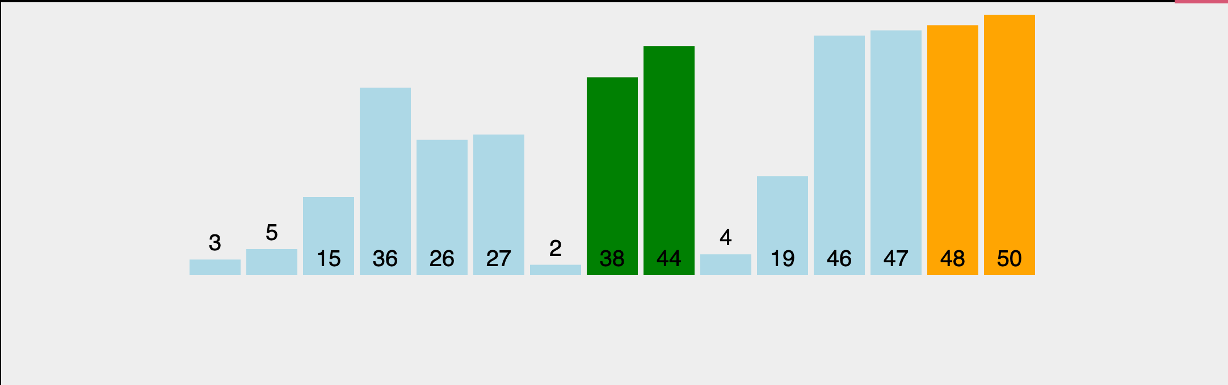
But what is the bubble sort??? (We do not teach it here)
https://visualgo.net/en/sorting
O(n²)

Slide 56
Insertion sort algorithm
0 | wendy
1 | alice
2 | dave
3 | walter
4 | carlos
5 | carol
6 | erin
7 | oscar
8 | peggy
9 | trudy
10 | eve
11 | trent
12 | bob
13 | craig
14 | frank
15 | victor
Insertion sort
Move down through the array.
Each item bubbles up above the larger ones above it.
Everything above the current item is in order.
Everything below the current item is untouched.
KIND OF like bubble sort, but not bubble sort.
We don't teach bubble sort any more because this is simpler and faster.

Slide 57
Insertion sort trace
LO 12.2b
0 | wendy
1 | alice
2 | dave
3 | walter
4 | carlos
5 | carol
6 | erin
7 | oscar
8 | peggy
9 | trudy
10 | eve
11 | trent
12 | bob
13 | craig
14 | frank
15 | victor
alice
wendy
dave
walter
carlos
carol
erin
oscar
peggy
trudy
eve
trent
bob
craig
frank
victor
alice
dave
wendy
walter
carlos
carol
erin
oscar
peggy
trudy
eve
trent
bob
craig
frank
victor
alice
dave
walter
wendy
carlos
carol
erin
oscar
peggy
trudy
eve
trent
bob
craig
frank
victor
alice
carlos
dave
walter
wendy
carol
erin
oscar
peggy
trudy
eve
trent
bob
craig
frank
victor
alice
carlos
carol
dave
walter
wendy
erin
oscar
peggy
trudy
eve
trent
bob
craig
frank
victor
alice
carlos
carol
dave
erin
walter
wendy
oscar
peggy
trudy
eve
trent
bob
craig
frank
victor
alice
carlos
carol
dave
erin
oscar
walter
wendy
peggy
trudy
eve
trent
bob
craig
frank
victor
alice
carlos
carol
dave
erin
oscar
peggy
walter
wendy
trudy
eve
trent
bob
craig
frank
victor
alice
carlos
carol
dave
erin
oscar
peggy
trudy
walter
wendy
eve
trent
bob
craig
frank
victor
alice
carlos
carol
dave
erin
eve
oscar
peggy
trudy
walter
wendy
trent
bob
craig
frank
victor
alice
carlos
carol
dave
erin
eve
oscar
peggy
trent
trudy
walter
wendy
bob
craig
frank
victor
alice
bob
carlos
carol
dave
erin
eve
oscar
peggy
trent
trudy
walter
wendy
craig
frank
victor
alice
bob
carlos
carol
craig
dave
erin
eve
oscar
peggy
trent
trudy
walter
wendy
frank
victor
alice
bob
carlos
carol
craig
dave
erin
eve
frank
oscar
peggy
trent
trudy
walter
wendy
victor
alice
bob
carlos
carol
craig
dave
erin
eve
frank
oscar
peggy
trent
trudy
victor
walter
wendy

Slide 58
Insertion sort: Java implementation
public class Insertion{
public static void sort(String[] a){
int N = a.length;
for (int i = 1; i < N; i++)
for (int j = i; j > 0; j--)
if (a[j-1].compareTo(a[j]) > 0)
exch(a, j-1, j);
else break; // UGH
}
private static void exch(String[] a, int i, int j)
{ String t = a[i]; a[i] = a[j]; a[j] = t; }
public static void main(String[] args) {
String[] a = StdIn.readAllStrings();
sort(a);
for (int i = 0; i < a.length; i++)
StdOut.println(a[i]);
}
}
% more names16.txt
wendy
alice
dave
walter
carlos
carol
erin
oscar
peggy
trudy
eve
trent
bob
craig
frank
victor
% java Insertion < names16.txt
alice
bob
carlos
carol
craig
dave
erin
eve
frank
oscar
peggy
trent
trudy
victor
walter
wendy

Slide 59
Empirical tests of insertion sort
N | TN (seconds) | TN/TN/2
20,000 | 1
40,000 | 4
80,000 | 35 | 9
160,000 | 225 | 6.4
320,000 | 1019 | 4.5
...
1.28 million | 14400 | 4
Sort random strings
Array of length N.
10-character strings.
% java Generator 20000 ...
1 seconds
% java Generator 40000 ...
4 seconds
% java Generator 80000 ...
35 seconds
% java Generator 160000 ...
225 seconds
% java Generator 320000 ...
1019 seconds
... = 10 a-z | java Insertion
a-z = abcdefghijklmnopqrstuvwxyz
4 hours
And 4x64/24 = 10+ days to sort 10 million? Sounds bad.
Confirms hypothesis that order of growth is N².
will NOT scale
Do you have anything better?

Slide 60
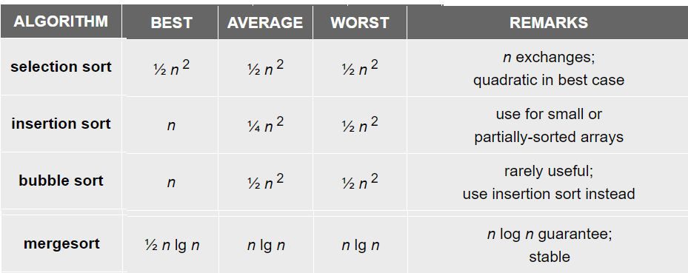
Finding best, average and worst cases
LO 12.2cd
Best case. Describe the performance of an algorithm under optimal conditions.
Worst case. A safe analysis of the performance of an algorithm under worst conditions.
Average case. A safe analysis of the performance of an algorithm under average conditions.
Notes:
(12.2d) Determine the best case, average case, and worst case Big-O analysis of the insertion search.
(12.2c) Determine the best case, average case, and worst case Big-O analysis of the selection search.

Slide 61
Practice
32 | 19 | 21 | 8 | 20 | 10 | 12

Slide 62
An interesting take on SORTING
Given an array of ints:
{2, -1, 5, 8, 2, 5, 6, 8, 8, -1, 999}
Print the elements in the array in decreasing order of frequency. If two elements have the same frequency, they should be printed in increasing numerical order. For the above array, the resulting output would be:
{8, 8, 8, -1, -1, 2, 2, 5, 5, 6, 999}
For next class…..DESCRIBE how you would solve this problem. Outline a plan. Give a guess as to how you would analyze your algorithm(s) and what you think the Big O analysis would be. Discuss space considerations (How are you dealing with your data?).

Slide 63
Image sources
Image sources
https://openclipart.org/detail/25617/astrid-graeber-adult-by-anonymous-25617
https://openclipart.org/detail/169320/girl-head-by-jza
Image sources
https://www.youtube.com/watch?v=k4RRi_ntQc8

Slide 64
12. Searching and Sorting
A typical client
Linear/sequential search
Binary search
Selection sort
Insertion sort

Slide 65
12. Searching and Sorting
Rutgers University
1.1–1.2

